Slide 1
CIS Automotive API
By
Praveen Kumar Attaluri

Slide 2
Market Statistics:- Pull real time market statistics, and raw listing data from our database of over 575M vehicles and 40k dealers from all over the US.
End Points:- Supply, pricing, vehicle, and sales data on the US automotive market on a brand and region basis.
database of 40k dealerships and over 430M vehicles.
Search for the Dealer inventories for the best priced cars.

Slide 3

Vehicle Identification Number(VIN)

Slide 4
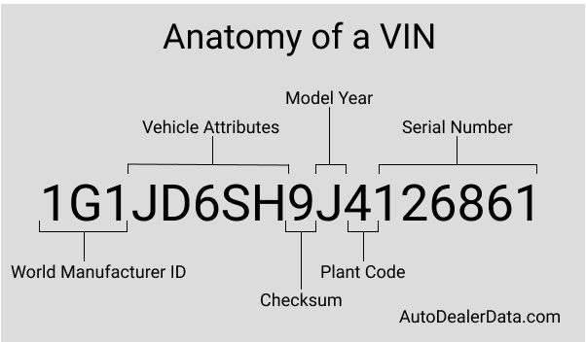
2018 Chevrolet Sonic LT that was built in Orion Michigan. We'll also see that GM issued a recall notice for some 2018 Sonics on May 27, 2018 to fix a weld affecting the safety of the driver's seat.

Slide 5
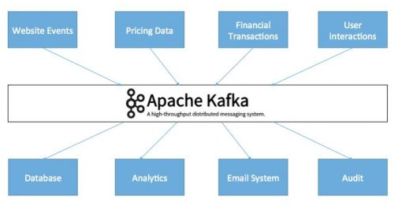
Kafka
Apache Kafka acts as a buffer so your systems won’t crash.
Reduces the need for multiple integrations.
Low latency and high throughput
Everyone can access data

